Slide 1
Group Meeting
Image Denoising: BM3D and BM3D-Net
Advisor : Jian-Jiun Ding
Student : Chih-Yu Tsai
2025.05.06
Digital Image & Signal Processing Lab

Slide 2
Outline(1/1)
Introduction
  Traditional Image Denoising Approaches
  Wavelet Thresholding Denoising
  NLM
BM3D
  Algorithm
  Directions for Improvement
BM3D-Net
Reference
Digital Image & Signal Processing Lab

Slide 3
Introduction(1/3)
Traditional Image Denoising Approaches
  Spatial domain filtering
    Ex : Local Filter (Weiner Filter) , Non-Local Filter (NLM) , …
  Transform domain filtering
    Ex : Wavelet Thresholding
  Statistical methods
    Ex : Hidden Markov Model（HMM）
  Dictionary learning methods
    Ex: K-SVD
  Hybrid method
    Ex: BM3D (popular) , TV (Total variation) + NLM
The basic principle of image denoising is that noise is uncorrelated with pixels, while pixels are highly correlated with each other.
Digital Image & Signal Processing Lab

Slide 4




Introduction(2/3)
Wavelet Thresholding
  Threshold Selection
  Thresholding Function
  Workflow
VisuShrink:
$λ= σ\sqrt{2log(M∗N)}$
BayesShrink:
$λ=\frac{σ_{n}^{2}}{σ_{x}^{2}}$
Hard-thresholding:
$H\left(x\right)= \left\{\begin{matrix}x , if |x|> λ \\ 0 , else \end{matrix}\right.$
Soft-thresholding:
$$S\left(x\right)= \left\{\begin{matrix}x−λ , if x> λ \\ \begin{matrix}0 , if abs\left(x\right)≤ λ \\ x+λ , if x<−λ\end{matrix}\end{matrix}\right.$$
Noise image
Denoise image
2D-DWT
Threshold
2D-IDWT
Digital Image & Signal Processing Lab

Slide 5
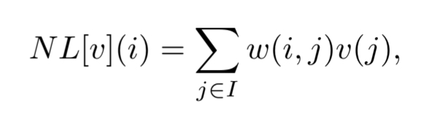
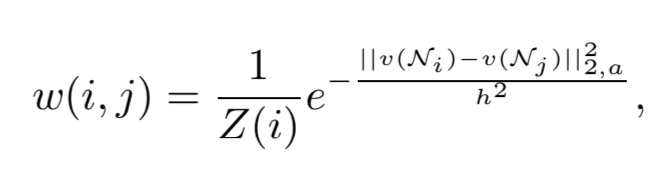
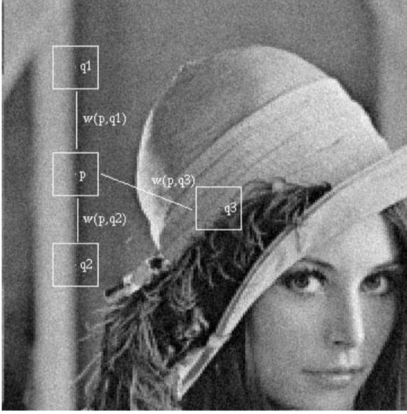
Introduction(3/3)
Non-Local Mean
  A complex texture image usually contains many similar patches, and denoising can be achieved by aggregating them through weighted averaging.
  Mathematical Formula :
  Disadvantages :
    Rare patch effect
    Risk of over-smoothing
  Improvements :
    Using hybrid methods (e.g., NLM + TV) for enhanced denoising
    performance
Digital Image & Signal Processing Lab

Slide 6
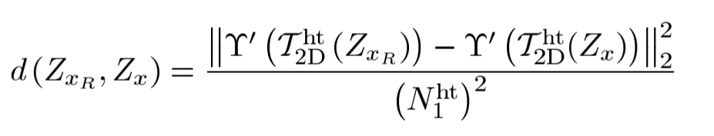

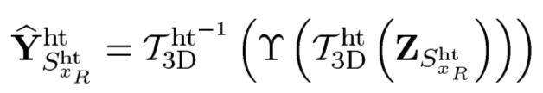
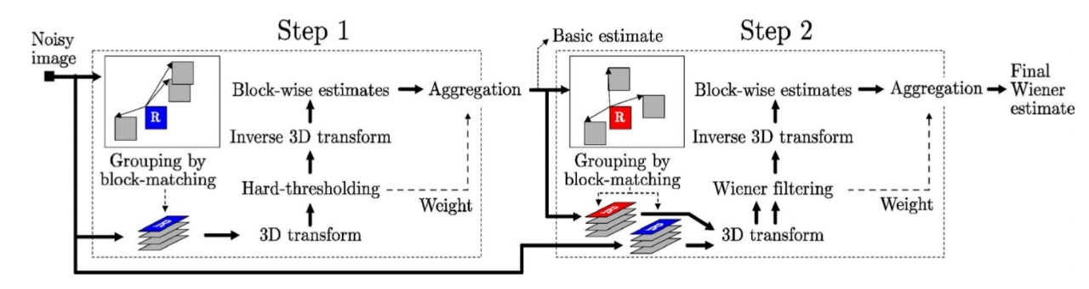

BM3D Algorithm(1/4)
Step1.
Block-wise estimates
  Grouping similar patches :
  Collaborative filtering : ($γ :$Hard-thresholding )
To get better matching
3D = 2D + 1D transform
No overlapping
Digital Image & Signal Processing Lab

Slide 7
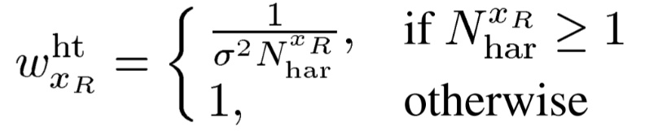
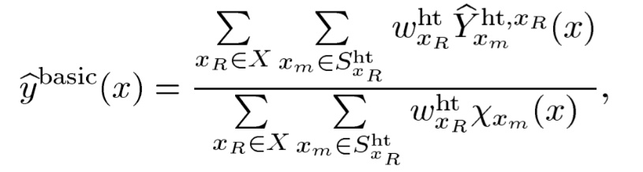
BM3D Algorithm(2/4)
Step1.
b) Aggregation
  Weight :
  Aggregation : weight average
The weights are inversely proportional to both the noise variance and the number of non-zero coefficients remaining after hard‐thresholding.
Digital Image & Signal Processing Lab

Slide 8
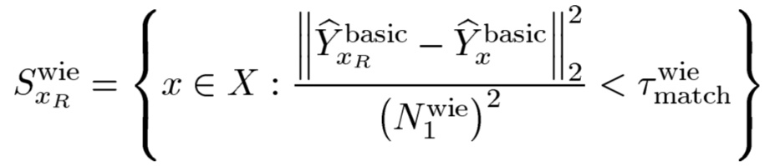
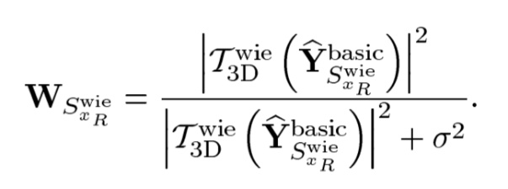
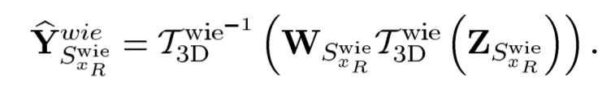

BM3D Algorithm(3/4)
Step2.
Block-wise estimates
  Grouping similar patches :
  Collaborative filtering : ($Γ :Wiener filter$)
Digital Image & Signal Processing Lab

Slide 9
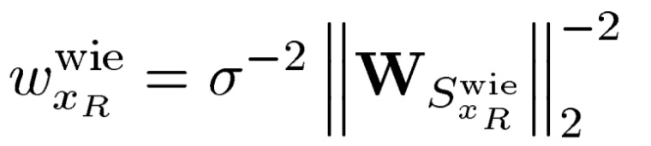
BM3D Algorithm(4/4)
Step2.
b) Aggregation
  Weight :
  Aggregation : (like step1.(bii))
    Get the final estimated image
Digital Image & Signal Processing Lab

Slide 10
Improved BM3D Algorithm(1/1)
  Better matching method
    Ex: Add KL distance or entropy to decide whether patches are similar
  Modify the weight formula
    Ex: Use entropy as a reference
  Improve noise estimation accuracy
  Solve rare patch effect
  Adaptive block shape
    Ex: BM3D-PCA[4] (using LPA-ICI) , Muti-scale block
Digital Image & Signal Processing Lab

Slide 11


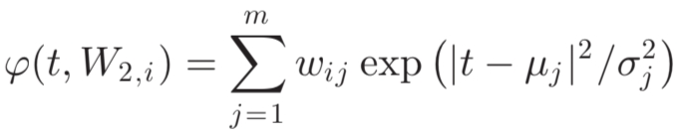
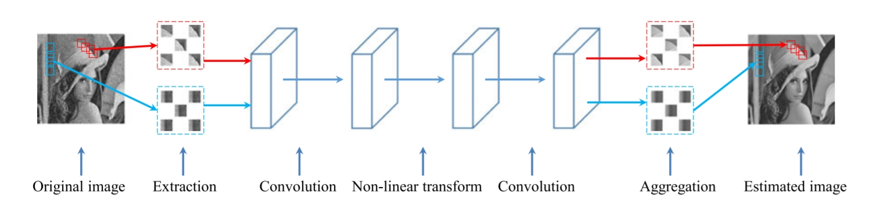
BM3D-Net(1/2)
  Mimicking the BM3D algorithm structure makes the neural network more interpretable.
  Grouping similar patches → Extraction layer :
  3D-Transform → Convolution layer :
  Hard-thresholding → Nonlinear transform layer :
:Learning parameter
: more flexible and efficient for denoising task
Digital Image & Signal Processing Lab

Slide 12
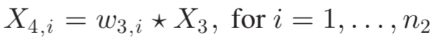
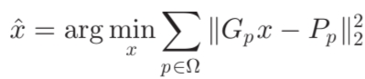
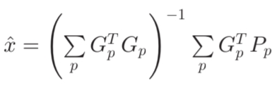
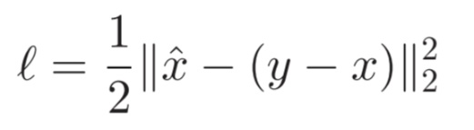
BM3D-Net(2/2)
  (iv) Inverse 3D-Transform → Convolution layer :
  (v) Aggregation → Aggregation layer :
  →
  Back to their original positions, and performing average among these overlapping patches
  (vi) Loss function
Learning the noise in a noise image instead of the clean image itself.
Digital Image & Signal Processing Lab

Slide 13
Reference(1/1)
  [1]: Dabov, Kostadin, et al. "Image denoising by sparse 3-D transform-domain collaborative filtering." IEEE Transactions on image processing 16.8 (2007): 2080-2095.
  [2]: A. Buades, B. Coll and J. . -M. Morel, "A non-local algorithm for image denoising," 2005 IEEE Computer Society Conference on Computer Vision and Pattern Recognition (CVPR'05), San Diego, CA, USA, 2005, pp. 60-65 vol. 2, doi: 10.1109/CVPR.2005.38.
  [3]: Yang, Dong, and Jian Sun. "BM3D-Net: A convolutional neural network for transform-domain collaborative filtering." IEEE Signal Processing Letters 25.1 (2017): 55-59.
  [4]: Dabov, Kostadin, et al. "BM3D image denoising with shape-adaptive principal component analysis." SPARS'09-Signal Processing with Adaptive Sparse Structured Representations. 2009.
  [5]: Goyal, Bhawna, et al. "Image denoising review: From classical to state-of-the-art approaches." Information fusion 55 (2020): 220-244.
Digital Image & Signal Processing Lab

Slide 14
    Thanks for Listening
Digital Image & Signal Processing Lab

